Slide 1
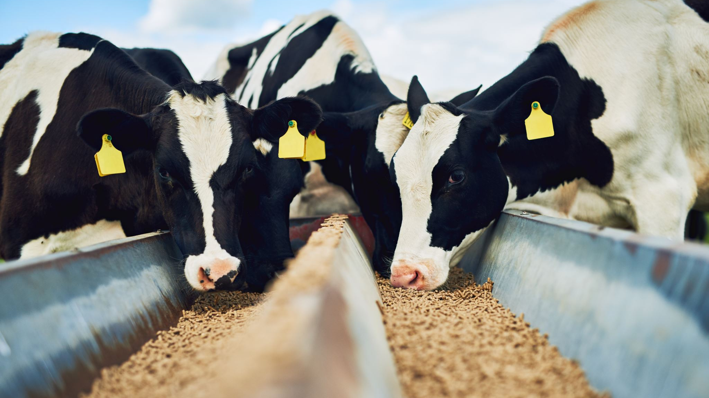
Ethanol, Food Prices, and renewable fuel standards

Slide 2
In the US 96 million acres are devoted to corn cultivation
27% of corn is used in Ethanol as a fuel, which increased with Renewable Fuel Standards from 2005 legislation
33% of corn is used in feed for livestock
Since corn is a significant link between fuel and food, how much do Ethanol prices drive the price of food?
Does Ethanol affect meat more than other food categories?
Will these findings support calls to change to the Renewable Fuel Standards policies?

Slide 3
Selecting the data
The US Department of Agriculture Economic Research Service:
Prices of corn, ethanol, gasoline, blender cost
From January 1982 to present day
The Bureau of Labor Statistics:
Prices for various food types
As early as 1967 through present day

Slide 4
After initial exploration of the data, I settled on the following food categories to consider:
Food generally
Meats
Fruits and Vegetables
Rice, pasta and cornmeal
Dairy
Hypothesis: Ethanol will have a significant impact on food and will have a larger impact on foods reliant on corn as feed, specifically meats and dairy, compared to food generally, fruits and vegetables, rice, pasta and cornmeal.

Slide 5
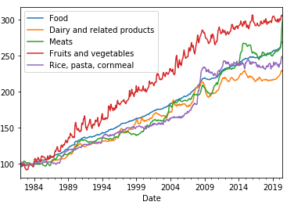
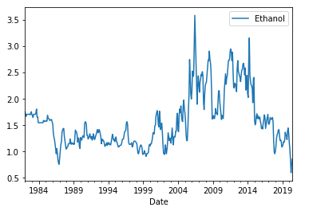
Comparing the timeseries 1984 - present
First impressions:
Prices are on vastly different scales
The food data shows significant upward trend, and is not stationary
Ethanol prices move more like a random walk, but are not stationary either
There is a huge spike in Ethanol prices after 2005 – around the time legislation mandated Ethanol use in gasoline
Food prices seem to jump significantly after 2005 as well

Slide 6
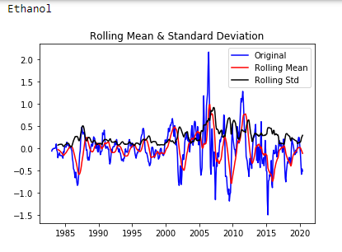
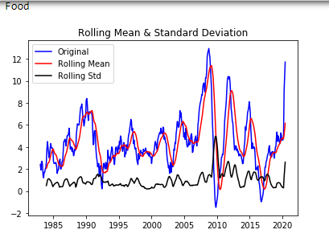
Testing stationarity
I tested stationarity using the Augmented Dicky Fuller test
None of the original series were considered stationary
I calculated annual differences for each timeseries
I created a new data frame of annual differences
I plotted each new timeseries with the rolling mean and standard deviation – all were stationary

Slide 7
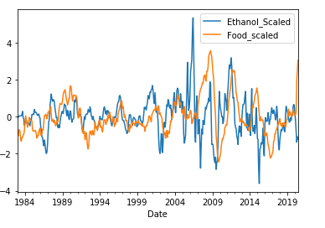
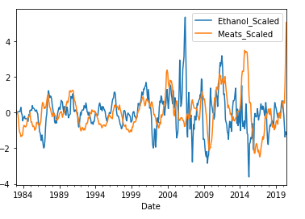
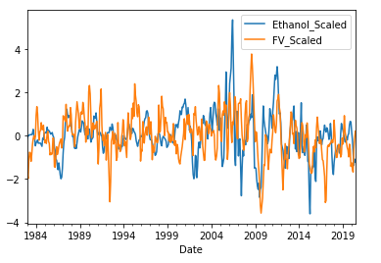
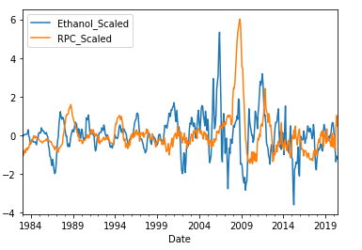
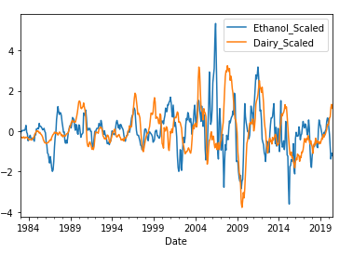
I scaled the annual differences and charted each food category against Ethanol
Some of the peaks and dips seem to coincide – but not all – and maybe with a lag of a few months

Slide 8
Creating the model
I split the time series into a train set from 1983 through 2012, and a test set for all points thereafter
I calculated the mean squared deviations and r2 for each lag 1-20 months
Based on results, I decided to use a lag of 5 months
Finally, I tested to see if the relationship was stronger by shortening test set to 2000-2016 and test for all points thereafter
I calculated the regression statistics for each model, and charted the r2 (next slide)

Slide 9

Model Continued
Overall, the model that trained on 2000 – 2016 with a lag of 5 months was the best, but none of the models yielded very high r2 scores
Furthermore, the difference between the r2 for Meats and Fruits and Vegetables was very small for two of the three models.
Fruits and Vegetables had a higher r2 than Dairy in all three models
 | Food | Meats | Fruits/Vegetables | Rice/Pasta/Cornmeal | Dairy
No lag 1983-2020 | 0.019 | 0.065 | 0.064 | 0.001 | 0.058
5-month lag 1983-2020 | 0.120 | 0.158 | 0.086 | 0.074 | 0.064
5-month lag 2000-2020 | 0.134 | 0.139 | 0.148 | 0.074 | 0.100

Slide 10
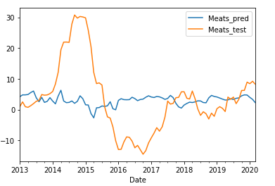
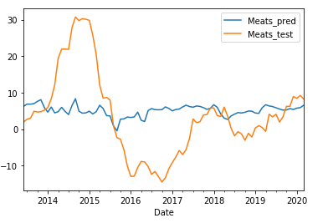
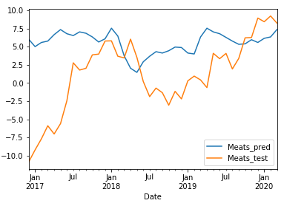
Predicted Values v Test Values
When looking at the predicted values plotted against the test values, the actual values showed a very large peak and dip, which the predicted values did not anticipate
There are clearly other important variables that need to be explored to predict the price of food categories
1983- 2020 no lag
1983- 2020 5-month lag
2000 - 2020 5-month lag

Slide 11
Conclusions
Ethanol and food do appear related – based on F statistics
At most changes in Ethanol prices only predict a small portion of variation in food category price changes
The impact on Meats was consistently higher than the Rice/Pasta/Cornmeal and Dairy
The impact on Meats was only slightly higher than Fruits/Vegetables
The findings do suggest that it plays a small part in food prices, but these findings do not provide strong justification for changing policy so much as the need for more study into this relationship

Slide 12
Future Study Questions
Why do Meats and Dairy products have different impacts, and why is the r2 for Fruits/Vegetables and Ethanol higher than Dairy and Ethanol?
How does Ethanol compare to other predictors of food prices in terms of r2?
What other forecasting models would be appropriate for this kind of econometric research?
How do alternatives to Ethanol compare in terms of impact of food prices?
This study only looks at American food prices. How does Ethanol impact world food prices?
It would be important to understand how emerging technologies may change prices, how climate change will affect food prices, and how different fuel options interact with both technology and climate changes.

